Slide 1
Chapter 1: Introduction

Slide 2
Chapter 1: Introduction
What Operating Systems Do
Computer-System Organization
Computer-System Architecture
Operating-System Operations
Resource Management
Security and Protection
Virtualization

Slide 3
What is an Operating System?
A program that acts as an intermediary between a user of a computer and the computer hardware
Operating system goals:
Execute user programs and make solving user problems easier
Make the computer system convenient to use
Use the computer hardware in an efficient manner

Slide 4
Computer System Structure
Computer system can be divided into four components:
Hardware – provides basic computing resources
CPU, memory, I/O devices
Operating system
Controls and coordinates use of hardware among various applications and users
Application programs – define the ways in which the system resources are used to solve the computing problems of the users
Word processors, compilers, web browsers, database systems, video games
Users
People, machines, other computers

Slide 5
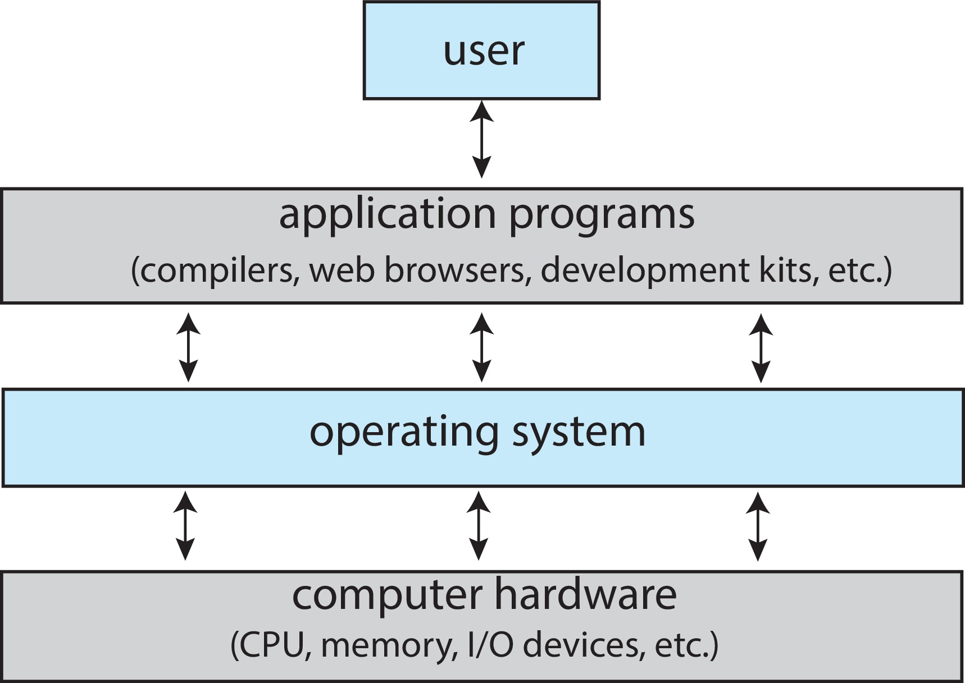
Abstract View of Components of Computer

Slide 6
What Operating Systems Do
Depends on the point of view
Users want convenience, ease of use and good performance
Don’t care about resource utilization
But shared computer such as mainframe or minicomputer must keep all users happy
Operating system is a resource allocator and control program making efficient use of HW and managing execution of user programs
Users of dedicate systems such as workstations have dedicated resources but frequently use shared resources from servers
Mobile devices like smartphones and tables are resource poor, optimized for usability and battery life
Mobile user interfaces such as touch screens, voice recognition
Some computers have little or no user interface, such as embedded computers in devices and automobiles
Run primarily without user intervention

Slide 7
Overview of Computer System Structure

Slide 8
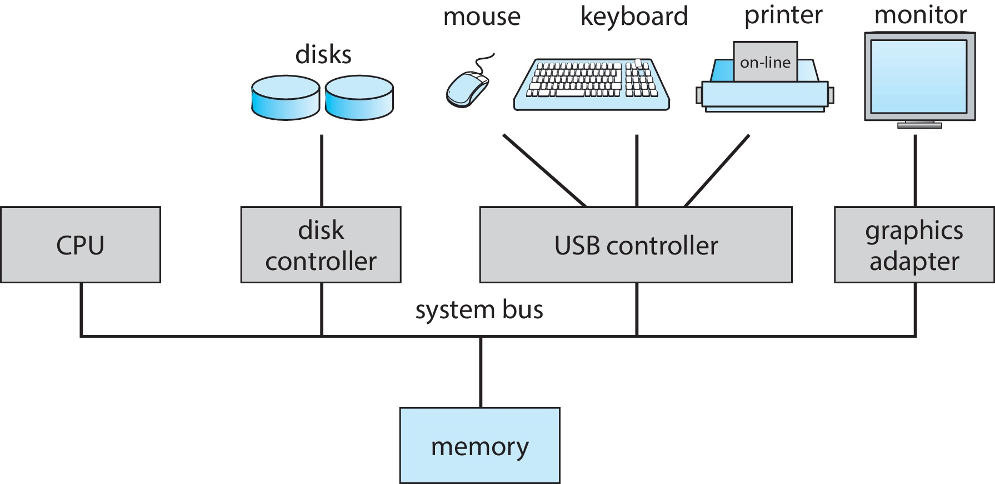
Computer System Organization
Computer-system operation
One or more CPUs, device controllers connect through common bus providing access to shared memory
Concurrent execution of CPUs and devices competing for memory cycles

Slide 9
Computer-System Operation
I/O devices and the CPU can execute concurrently
Each device controller is in charge of a particular device type
Each device controller has a local buffer
Each device controller type has an operating system device driver to manage it
CPU moves data from/to main memory to/from local buffers
I/O is from the device to local buffer of controller
Device controller informs CPU that it has finished its operation by causing an interrupt

Slide 10
Operating-System Operations
Bootstrap program – simple code to initialize the system, load the kernel
Kernel loads
Starts system daemons (services provided outside of the kernel)
Kernel interrupt driven (hardware and software)
Hardware interrupt by one of the devices
Software interrupt (exception or trap):
Software error (e.g., division by zero)
Request for operating system service – system call
Other process problems include infinite loop, processes modifying each other or the operating system

Slide 11
Multiprogramming (Batch system)
Single user cannot always keep CPU and I/O devices busy
Multiprogramming organizes jobs (code and data) so CPU always has one to execute
A subset of total jobs in system is kept in memory
One job selected and run via job scheduling
When job has to wait (for I/O for example), OS switches to another job

Slide 12
Multitasking (Timesharing)
A logical extension of Batch systems– the CPU switches jobs so frequently that users can interact with each job while it is running, creating interactive computing
Response time should be < 1 second
Each user has at least one program executing in memory  process
If several jobs ready to run at the same time  CPU scheduling
If processes don’t fit in memory, swapping moves them in and out to run
Virtual memory allows execution of processes not completely in memory

Slide 13
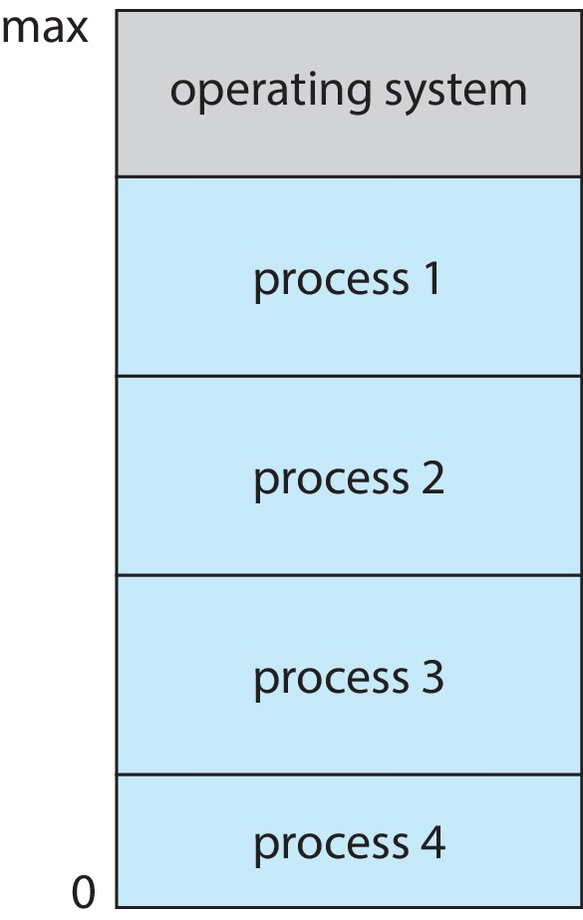
Memory Layout for Multiprogrammed System

Slide 14
Dual-mode Operation
Dual-mode operation allows OS to protect itself and other system components
User mode and kernel mode
Mode bit provided by hardware
Provides ability to distinguish when system is running user code or kernel code.
When a user is running  mode bit is “user”
When kernel code is executing  mode bit is “kernel”
How do we guarantee that user does not explicitly set the mode bit to “kernel”?
System call changes mode to kernel, return from call resets it to user
Some instructions designated as privileged, only executable in kernel mode

Slide 15
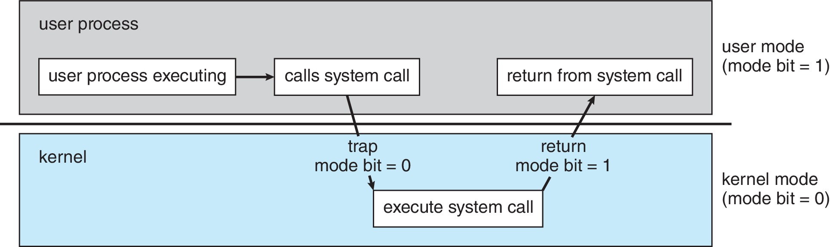
Transition from User to Kernel Mode

Slide 16
Virtualization
Allows operating systems to run applications within other OSes
Vast and growing industry
Emulation used when source CPU type different from target type (i.e. PowerPC to Intel x86)
Generally slowest method
When computer language not compiled to native code – Interpretation
Virtualization – OS natively compiled for CPU, running guest OSes also natively compiled
Consider VMware running WinXP guests, each running applications, all on native WinXP host OS
VMM (virtual machine Manager) provides virtualization services

Slide 17
Virtualization (cont.)
Use cases involve laptops and desktops running multiple OSes for exploration or compatibility
Apple laptop running Mac OS X host, Windows as a guest
Developing apps for multiple OSes without having multiple systems
Quality assurance testing applications without having multiple systems
Executing and managing compute environments within data centers
VMM can run natively, in which case they are also the host
There is no general-purpose host then (VMware ESX and Citrix XenServer)

Slide 18
Computing Environments - Virtualization

Slide 19
(Self Study)
Computer System Architecture

Slide 20
Computer-System Architecture (Self Study)
Most systems use a single general-purpose processor
Most systems have special-purpose processors as well
Multiprocessors systems growing in use and importance
Also known as parallel systems, tightly-coupled systems
Advantages include:
Increased throughput
Economy of scale
Increased reliability – graceful degradation or fault tolerance
Two types:
Asymmetric Multiprocessing – each processor is assigned a specie task.
Symmetric Multiprocessing – each processor performs all tasks

Slide 21
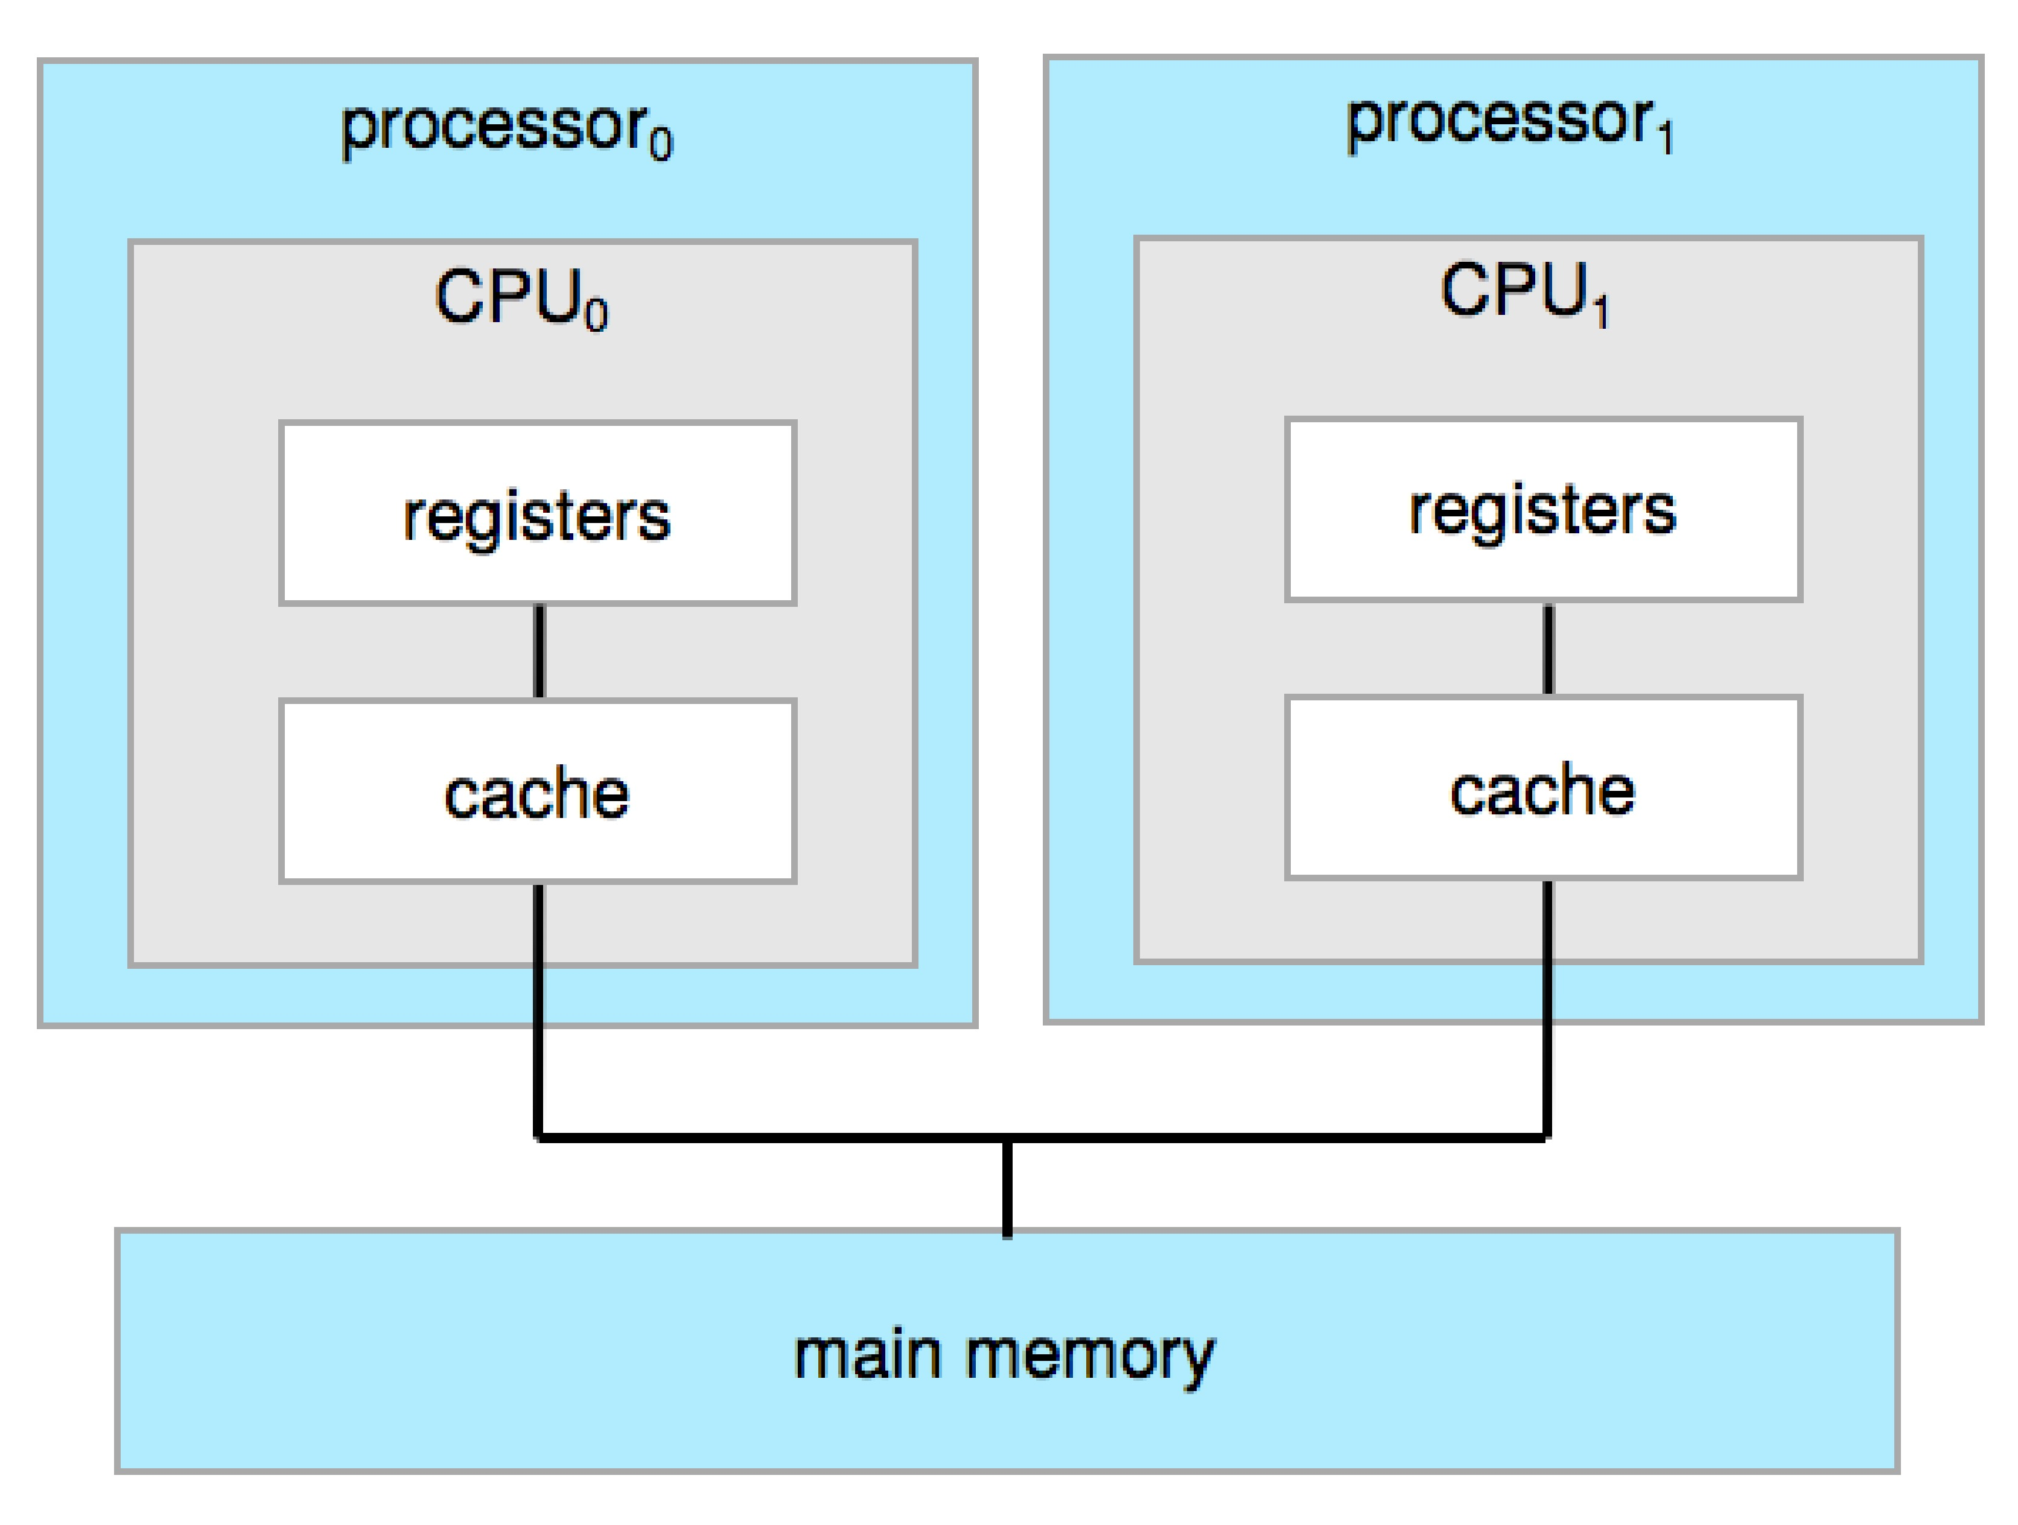
Symmetric Multiprocessing Architecture (Self Study)

Slide 22
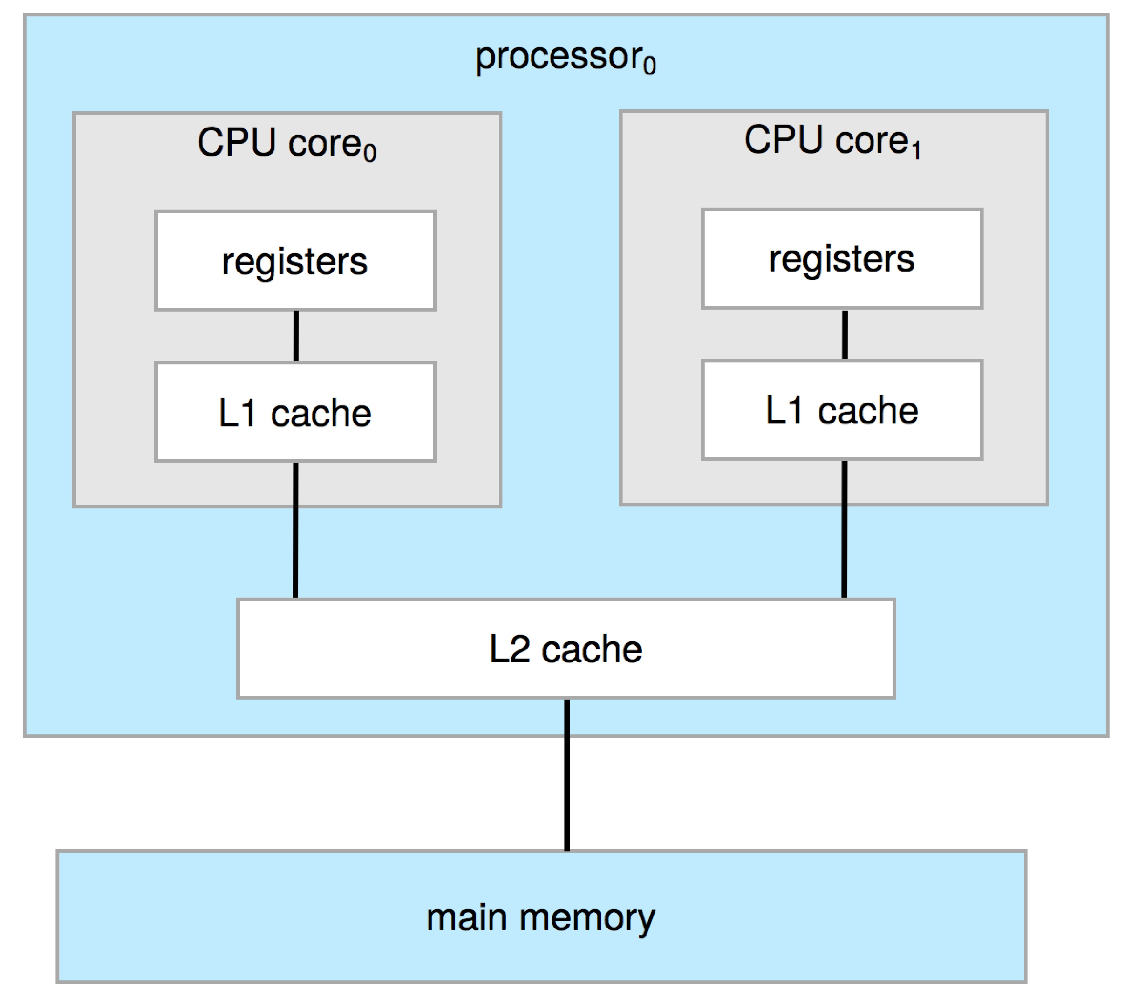
Dual-Core Design (Self Study)
Multi-chip and multicore
Systems containing all chips
Chassis containing multiple separate systems

Slide 23
Chapter 1(Cont’d): Operating-System Services

Slide 24
Outline
Operating System Services
User and Operating System-Interface
System Calls
Operating System Structure

Slide 25
Operating System Services
Operating systems provide an environment for execution of programs and services to programs and users
One set of operating-system services provides functions that are helpful to the user:
User interface - Almost all operating systems have a user interface (UI).
Varies between Command-Line (CLI), Graphics User Interface (GUI), touch-screen, Batch
Program execution - The system must be able to load a program into memory and to run that program, end execution, either normally or abnormally (indicating error)
I/O operations - A running program may require I/O, which may involve a file or an I/O device
File-system manipulation - The file system is of particular interest. Programs need to read and write files and directories, create and delete them, search them, list file Information, permission management.

Slide 26
Operating System Services (Cont.)
One set of operating-system services provides functions that are helpful to the user (Cont.):
Communications – Processes may exchange information, on the same computer or between computers over a network
Communications may be via shared memory or through message passing (packets moved by the OS)
Error detection – OS needs to be constantly aware of possible errors
May occur in the CPU and memory hardware, in I/O devices, in user program
For each type of error, OS should take the appropriate action to ensure correct and consistent computing
Debugging facilities can greatly enhance the user’s and programmer’s abilities to efficiently use the system

Slide 27
Operating System Services (Cont.)
Another set of OS functions exists for ensuring the efficient operation of the system itself via resource sharing
Resource allocation - When multiple users or multiple jobs running concurrently, resources must be allocated to each of them
Many types of resources - CPU cycles, main memory, file storage, I/O devices.
Logging - To keep track of which users use how much and what kinds of computer resources
Protection and security - The owners of information stored in a multiuser or networked computer system may want to control use of that information, concurrent processes should not interfere with each other
Protection involves ensuring that all access to system resources is controlled
Security of the system from outsiders requires user authentication, extends to defending external I/O devices from invalid access attempts

Slide 28
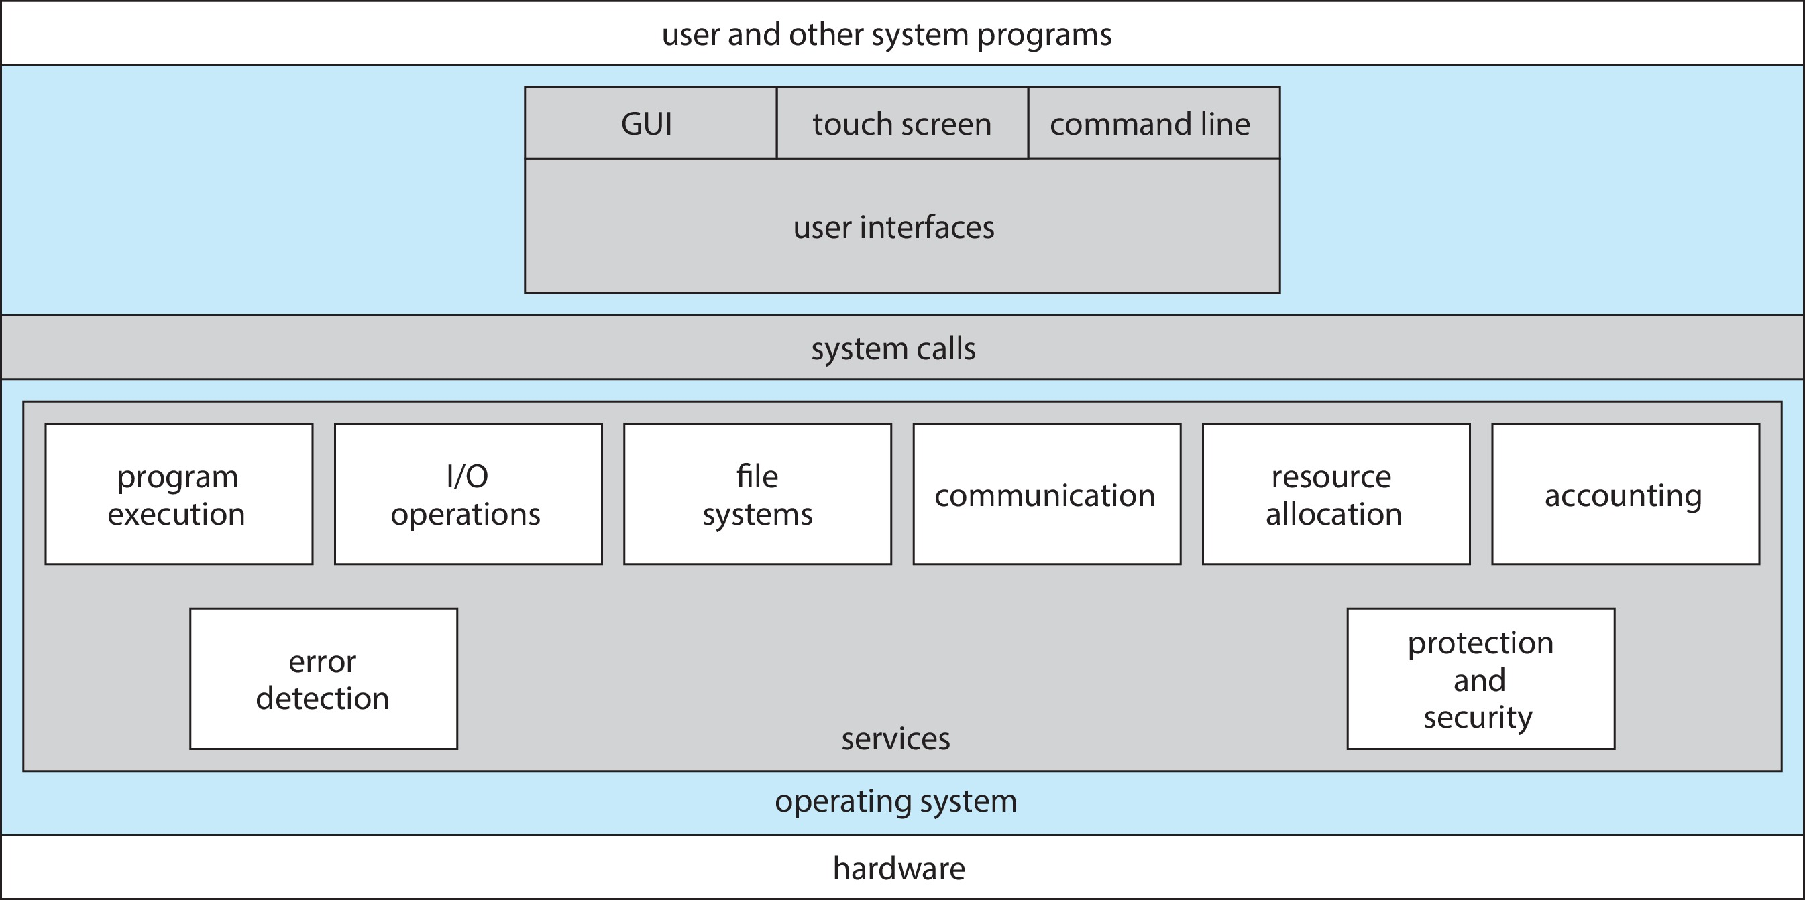
A View of Operating System Services

Slide 29
Command Line interpreter (Self Study)
CLI allows direct command entry
Sometimes implemented in kernel, sometimes by systems program
Sometimes multiple flavors implemented – shells
Primarily fetches a command from user and executes it
Sometimes commands built-in, sometimes just names of programs
If the latter, adding new features doesn’t require shell modification

Slide 30
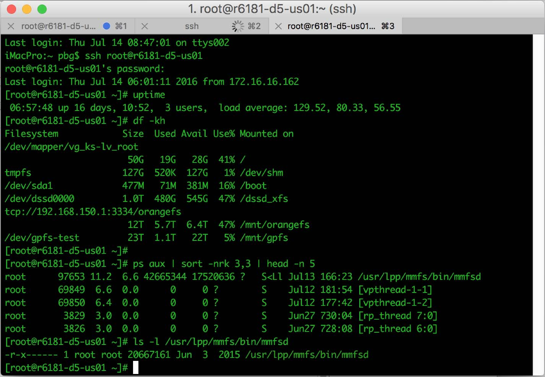
Bourne Shell Command Interpreter (Self Study)

Slide 31
User Operating System Interface - GUI (Self Study)
User-friendly desktop metaphor interface
Usually mouse, keyboard, and monitor
Icons represent files, programs, actions, etc
Various mouse buttons over objects in the interface cause various actions (provide information, options, execute function, open directory (known as a folder)
Invented at Xerox PARC
Many systems now include both CLI and GUI interfaces
Microsoft Windows is GUI with CLI “command” shell
Apple Mac OS X is “Aqua” GUI interface with UNIX kernel underneath and shells available
Unix and Linux have CLI with optional GUI interfaces (CDE, KDE, GNOME)

Slide 32
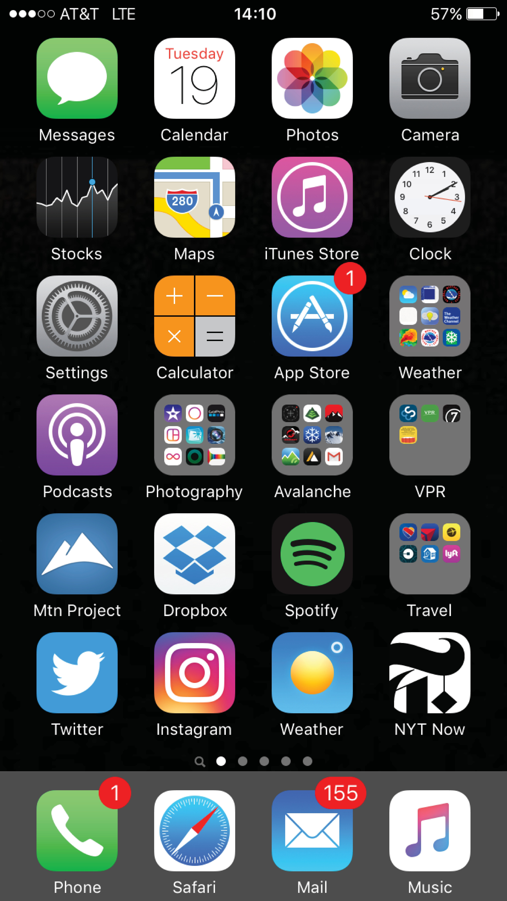
Touchscreen Interfaces (Self Study)
Touchscreen devices require new interfaces
Mouse not possible or not desired
Actions and selection based on gestures
Virtual keyboard for text entry
Voice commands

Slide 33
The Mac OS X GUI (Self Study)

Slide 34
System Calls (Self Study)
Programming interface to the services provided by the OS
Typically written in a high-level language (C or C++)
Mostly accessed by programs via a high-level Application Programming Interface (API) rather than direct system call use
Three most common APIs are Win32 API for Windows, POSIX API for POSIX-based systems (including virtually all versions of UNIX, Linux, and Mac OS X), and Java API for the Java virtual machine (JVM)
Note that the system-call names used throughout this text are generic

Slide 35
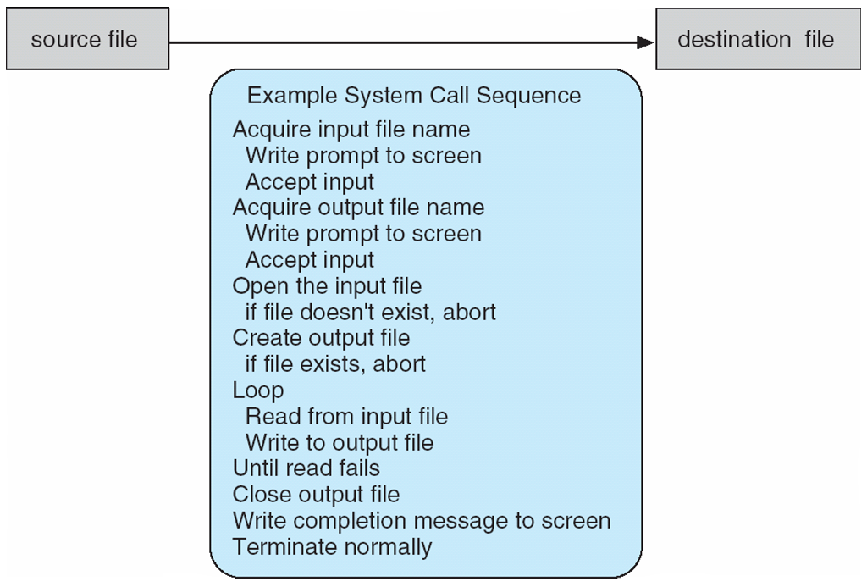
Example of System Calls (Self Study)
System call sequence to copy the contents of one file to another file

Slide 36
System Call Implementation (Self Study)
Typically, a number is associated with each system call
System-call interface maintains a table indexed according to these numbers
The system call interface invokes the intended system call in OS kernel and returns status of the system call and any return values
The caller need know nothing about how the system call is implemented
Just needs to obey API and understand what OS will do as a result call
Most details of OS interface hidden from programmer by API
Managed by run-time support library (set of functions built into libraries included with compiler)

Slide 37
Types of System Calls (Self Study)
Process control
create process, terminate process
end, abort
load, execute
get process attributes, set process attributes
wait for time
wait event, signal event
allocate and free memory
Dump memory if error
Debugger for determining bugs, single step execution
Locks for managing access to shared data between processes

Slide 38
Types of System Calls (Cont.) (Self Study)
File management
create file, delete file
open, close file
read, write, reposition
get and set file attributes
Device management
request device, release device
read, write, reposition
get device attributes, set device attributes
logically attach or detach devices

Slide 39
Types of System Calls (Cont.) (Self Study)
Information maintenance
get time or date, set time or date
get system data, set system data
get and set process, file, or device attributes
Communications
create, delete communication connection
send, receive messages if message passing model to host name or process name
From client to server
Shared-memory model create and gain access to memory regions
transfer status information
attach and detach remote devices

Slide 40
Types of System Calls (Cont.) (Self Study)
Protection
Control access to resources
Get and set permissions
Allow and deny user access

Slide 41
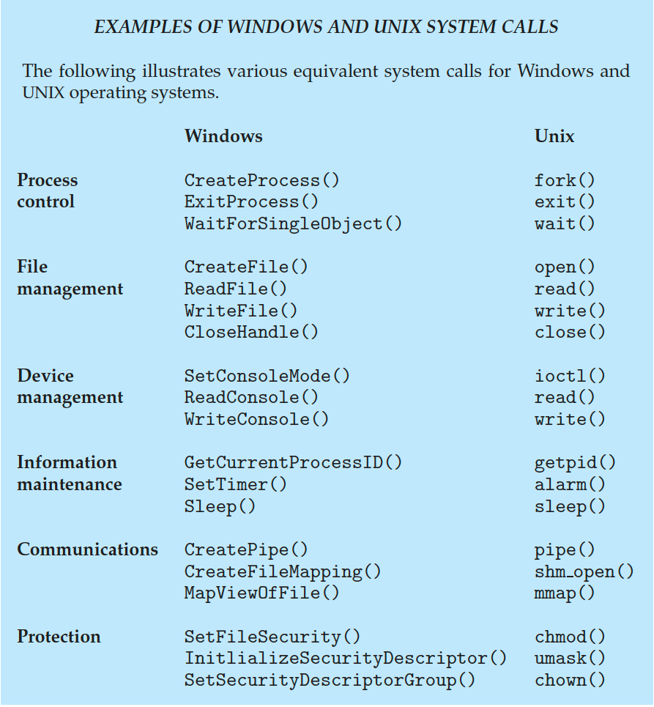
Examples of Windows and Unix System Calls (Self Study)

Slide 42
Operating System Structure
General-purpose OS is very large program
Various ways to structure ones
Simple structure – MS-DOS
More complex – UNIX
Layered – an abstraction
Microkernel – Mach

Slide 43
Monolithic Structure – Original UNIX
UNIX – limited by hardware functionality, the original UNIX operating system had limited structuring.
The UNIX OS consists of two separable parts
Systems programs
The kernel
Consists of everything below the system-call interface and above the physical hardware
Provides the file system, CPU scheduling, memory management, and other operating-system functions; a large number of functions for one level

Slide 44
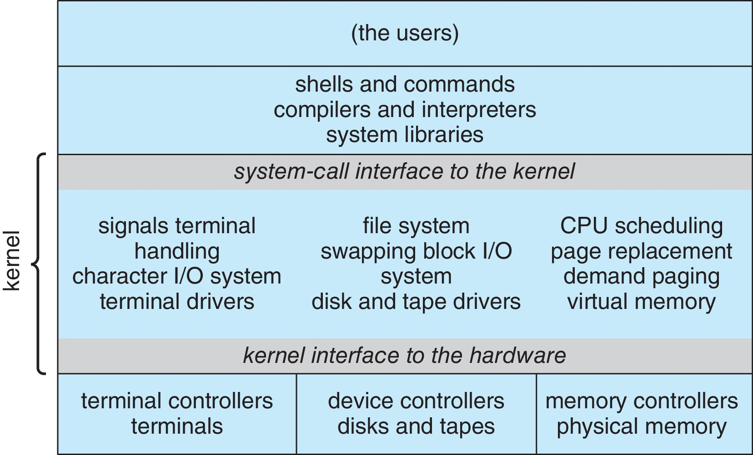
Traditional UNIX System Structure (Self Study)
Beyond simple but not fully layered

Slide 45
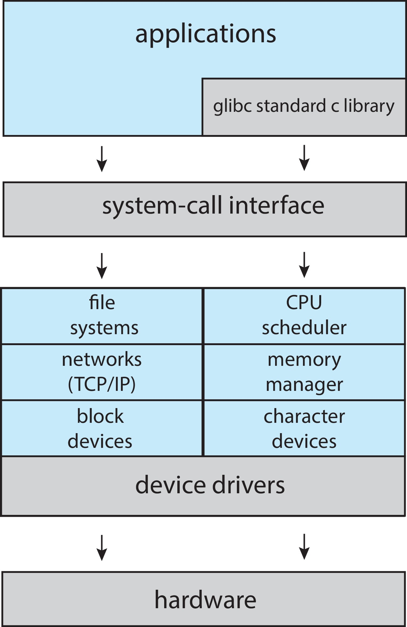
Linux System Structure (Self Study)
Monolithic plus modular design

Slide 46
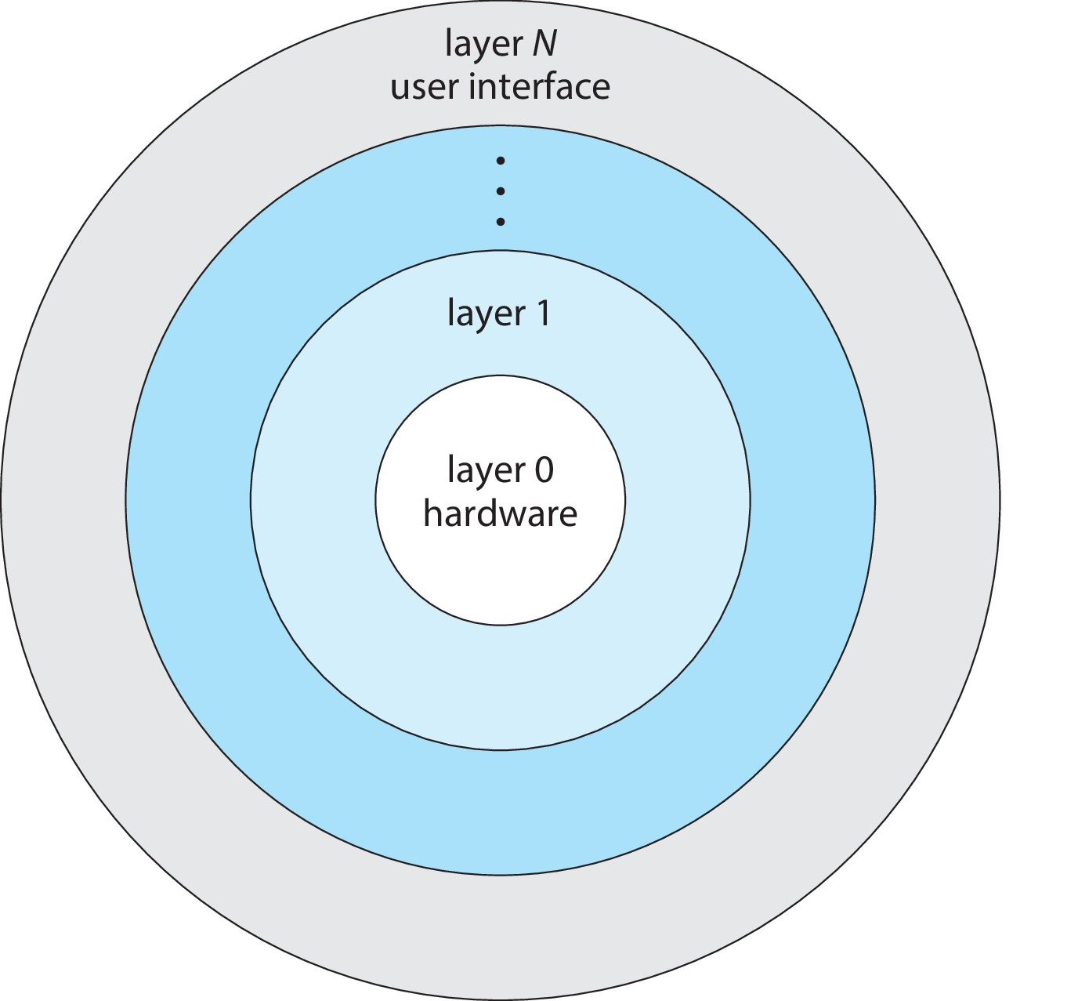
Layered Approach
The operating system is divided into a number of layers (levels), each built on top of lower layers. The bottom layer (layer 0), is the hardware; the highest (layer N) is the user interface.
With modularity, layers are selected such that each uses functions (operations) and services of only lower-level layers

Slide 47
Microkernels
Moves as much from the kernel into user space
Mach is an example of microkernel
Mac OS X kernel (Darwin) partly based on Mach
Communication takes place between user modules using message passing
Benefits:
Easier to extend a microkernel
Easier to port the operating system to new architectures
More reliable (less code is running in kernel mode)
More secure
Detriments:
Performance overhead of user space to kernel space communication

Slide 48
Microkernel System Structure

Slide 49
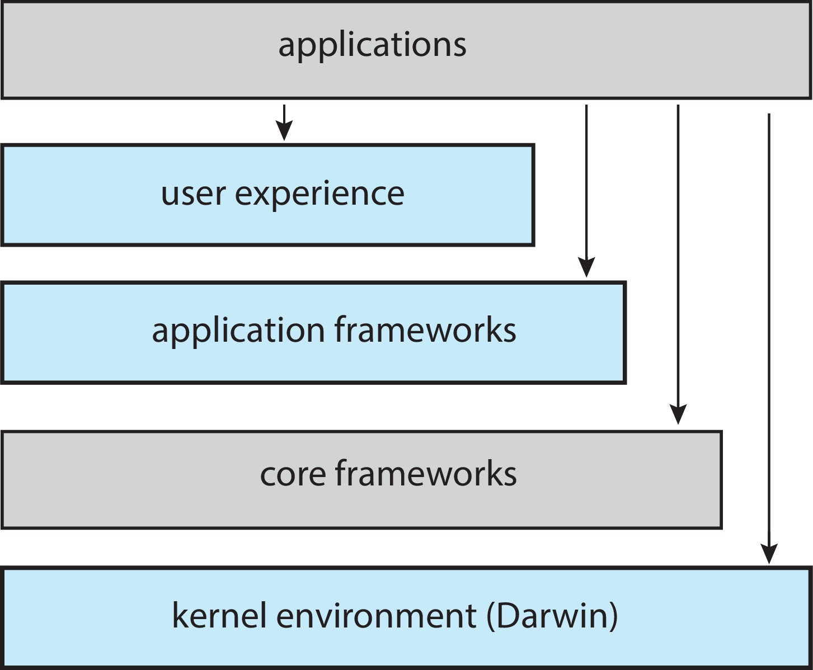
macOS and iOS Structure (Self Study)

Slide 50
Android (Self Study)
Developed by Open Handset Alliance (mostly Google)
Open Source
Similar stack to iOS
Based on Linux kernel but modified
Provides process, memory, device-driver management
Adds power management
Runtime environment includes core set of libraries and Dalvik virtual machine
Apps developed in Java plus Android API
Java class files compiled to Java bytecode then translated to executable thnn runs in Dalvik VM
Libraries include frameworks for web browser (webkit), database (SQLite), multimedia, smaller libc

Slide 51
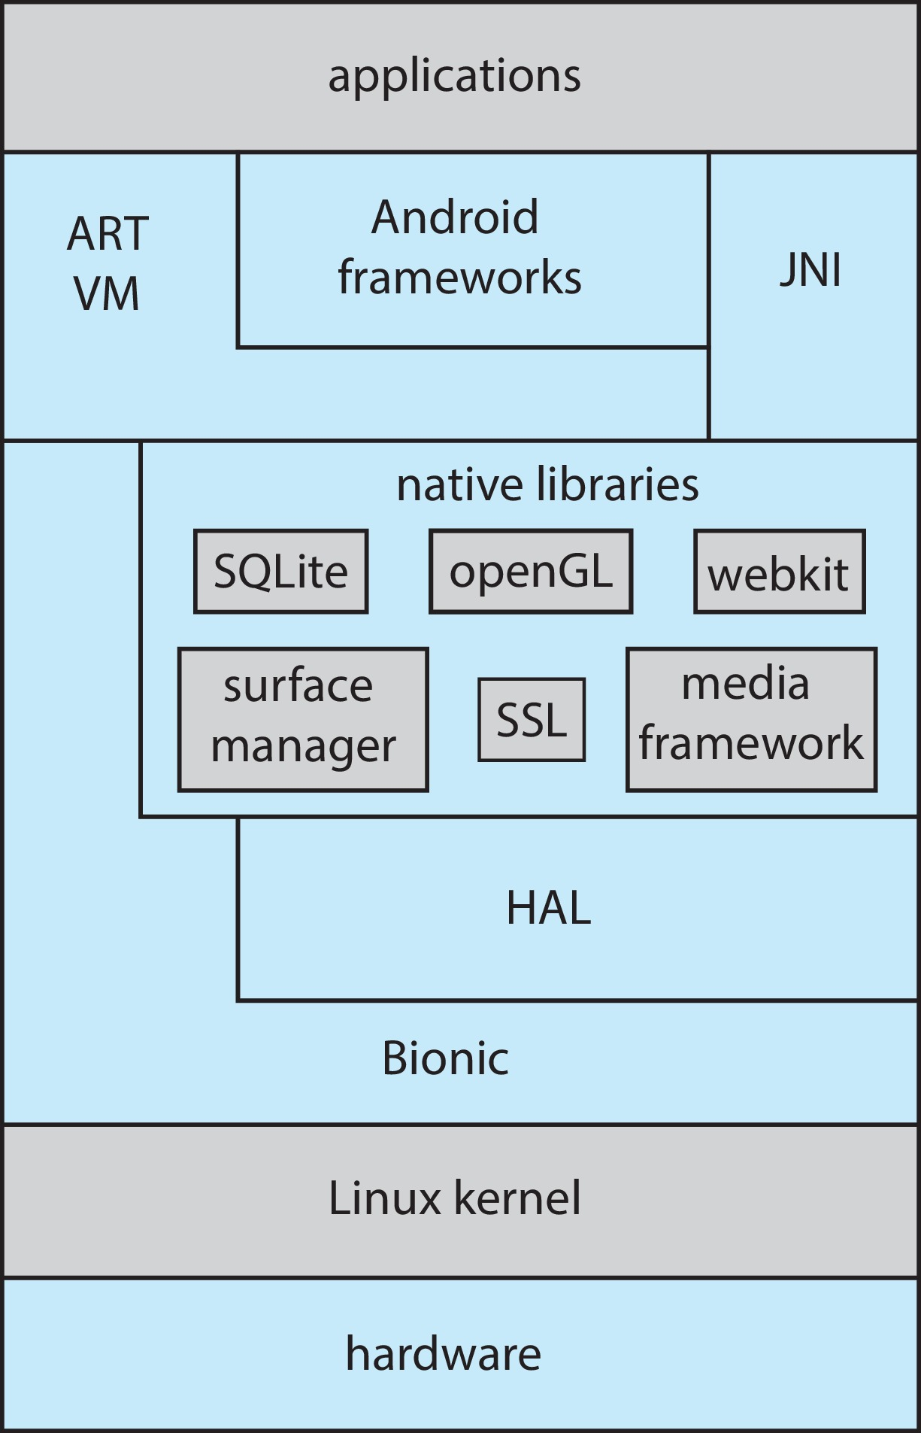
Android Architecture (Self Study)

Slide 52
End of Chapter 1

